Slide 1
Buying, Selling, Transitioning
a Medical Practice
Saving Private Practice Series
Santa Clara County Medical Association
Presented By:
Debra Phairas
WWW.PRACTICECONSULTANTS.NET
© Copyrighted Practice & Liability Consultants, LLC 1992, updated yearly, 2024

Slide 2
Today’s Webinar Presenter
Debra Phairas
President
Practice & Liability Consultants, LLC
Notes:
READ: Debra Phairas is President of Practice & Liability Consultants, LLC a nationally recognized firm specializing in practice management and malpractice prevention. Her background includes medical clinic administration and loss prevention management for NORCAL Mutual, a physician malpractice insurance carrier in Northern California. Her BS is from Michigan State University and her graduate work at Golden Gate University San Francisco MBA Health Services Administration program. Her consulting experience includes over 2,000 practices of all sizes and specialties. Typical engagements include: practice start-ups, practice assessments, mergers, financial analysis, revenue enhancement, overhead reduction, personnel management, over 500 practice valuations, expert witness, partnership issues and recruitment support for hospitals and physician groups. She has presented seminars and lectures nationwide for state and local medical/dental associations, management organizations and specialty societies. Please view her website here: www.practiceconsultants.net

Slide 3
“The speaker does not have any financial relationships with ineligible companies to disclose”

Slide 4
Feeling like this?

Slide 5
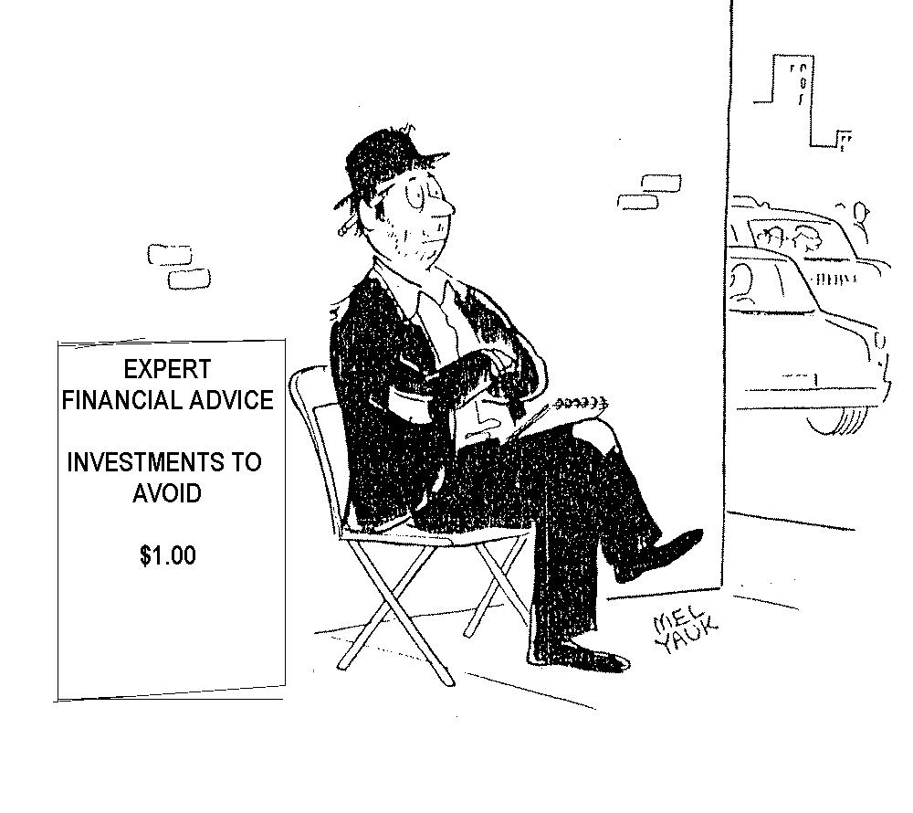

Slide 6
Planning now will avoid this scenario:
You have devoted long years to a practice
You are physically ready to retire
You want to retire, but you cannot afford to.

Slide 7
The Senior Physician
Why slow down when you are having fun???????

Slide 9
San Francisco Business Times March 16, 2018

Slide 11
James F. Sweeney Medical Economics Feb 13, 2019 Why it is hard for physicians to retire

Slide 12
Medical Economics Comp Health Study Sept 2017
“Physicians spend all day talking to patients,” Good says. “My friends who have retired do report loneliness and isolation and those considering [retirement] note it is a concern.”
In the study, 51% of respondents said that still working occasionally or part-time is part of their ideal retirement plans.

Slide 13
The Maven Project
Laurie Green keeps retired doctors working with health clinics for needy
SF Chronicle By Erin Allday February 17, 2018 Updated: February 17, 2018 1:32pm
Connects volunteer physicians, most of them retired or nearly so, with health clinics that serve patients who may not have access to expert specialty care. Green describes it as “Match.com meets the Peace Corps.”

Slide 14
The best (and worst) places for doctors to retire

Slide 15
Top five retirement locations for affordability
5) Memphis, TN
4) Knoxville, TN
3) Mobile, AL
2) Montgomery, AL
1) Fort Smith, AR

Slide 16
Top five retirement locations for activities
5) Honolulu, HI
4) San Francisco, CA
3) Cincinnati, OH
2) Minneapolis, MN
1) Washington, DC

Slide 17
Top five retirement locations for quality of life
5) Glendale, CA
4) Madison, WI
3) Honolulu, HI
2) Scottsdale, AZ
1) Fremont, CA

Slide 18
Top five retirement locations for health care
5) Columbia, MD
4) Juneau, AK
3) Sioux Falls, SD
2) Burlington, VT
1) South Burlington, VT

Slide 19
Ten worst places to retire (ranked by overall score)
Rank | Score
173) Arlington, TX | 41.84
174) Jersey City, NJ | 41.78
175) Detroit, MI | 41.48
176) Vancouver, WA | 41.26
177) Wichita, KS | 40.56

Slide 20
Ten worst places to retire, cont’d
Rank | Score
178) Rancho Cucamonga, CA | 40.54
179) Spokane, WA | 40.23
180) Bridgeport, CT | 39.34
181) Newark, NJ | 38.53
182) San Bernardino, CA | 37.55

Slide 21
Ten best places to retire, ranked by overall score
Rank | Score
10) Atlanta, CA | 58.04
9) Miami, FL | 58.05
8) Fort Lauderdale, FL | 58.37
7) Cincinnati, OH | 58.37
6) Denver, CO | 59.45

Slide 22
Ten best places to retire, cont’d
Rank | Score
5) Minneapolis, MN | 59.98
4) Tampa, FL | 60.38
3) Scottsdale, AZ | 60.58
2) Charleston, SC | 61.97
1) Orlando, FL | 62.14

Slide 23
Semi Retirement
Prepare Revenue/Expense Projections
If solo, value of practice is tied to Revenue
Overhead expense share – Minimum $
Income Share based on Productivity will adjust
What is dropping call worth? Can estimate hourly wage and deduct from income or group pays doctors to take call

Slide 25
Partnership Elements
Recommend 6-12 months notice of termination – Partners/Groups need this time to recruit/find another doctor
Less notice, forfeit % of A/R, e.g.,
1 month = 20% of A/R
2 months = 40% etc.

Slide 26
Death & Disability
Surviving spouse should call the local medical society for support
Hire a locum tenens immediately if partners are unable to absorb practice load
See Sources of Information for Surviving Spouses

Slide 27
Spouses and Offices Manager need to be able to locate:
Bank accounts
Safe Deposit Boxes
Credit Cards
Will

Slide 28
Spouses and Offices Manager need to be able to locate:
Income tax records
3 Years of Profit/Loss and Balance Sheets
Lease agreements for practice and equipment
Life, disability and health insurance policies

Slide 29
Spouses and Offices Manager need to be able to locate:
Malpractice, Key man and Overhead insurance policies
Supply and equipment inventory
Staff wages and positions

Slide 30
Who will be impacted by your retirement?
You
Your spouse / children
Your staff
Your patients

Slide 31
Closing Your Practice
Professional liability coverage
“Tail” coverage
Retain policies

Slide 32
Avoid Abandonment Claims
AMA ethics
Notify patients via letter

Slide 33
Letter to Patients
Date of Closing/transfer
Opportunity to select new physicians and transfer records to him/her.
Where records will be stored
Note of thanks to your patients

Slide 34
Letter to Patients
Authorization to transfer records form which patients can sign and send in
List of other physicians who are willing to accept your patients

Slide 35
Who Should Receive Letter:
All “active” patients, seen within past 1-2 years
Chronic illness patients who need follow-up
No letter is needed for a patient who has been discharged from care with a “Withdrawal from Care” letter

Slide 36
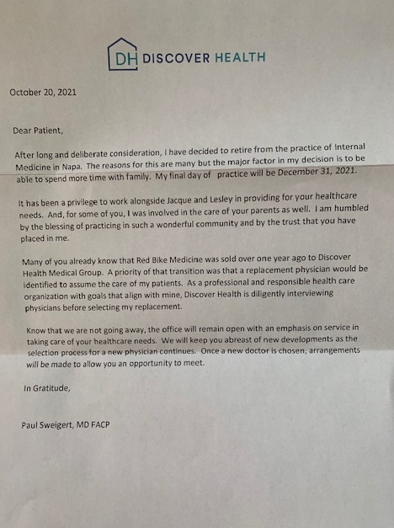

Slide 37
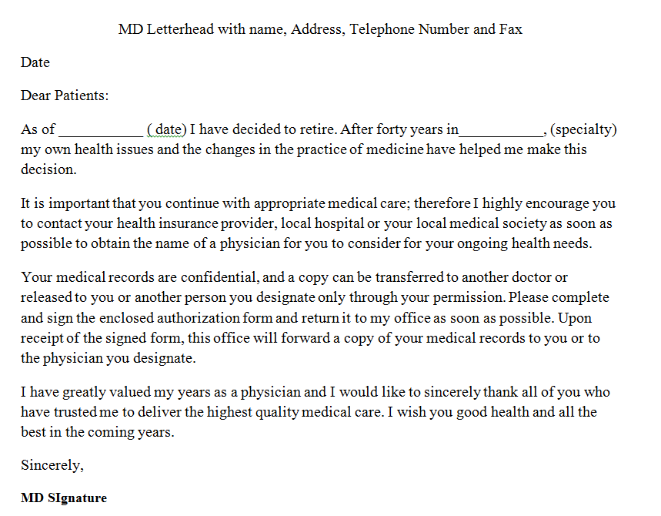

Slide 38
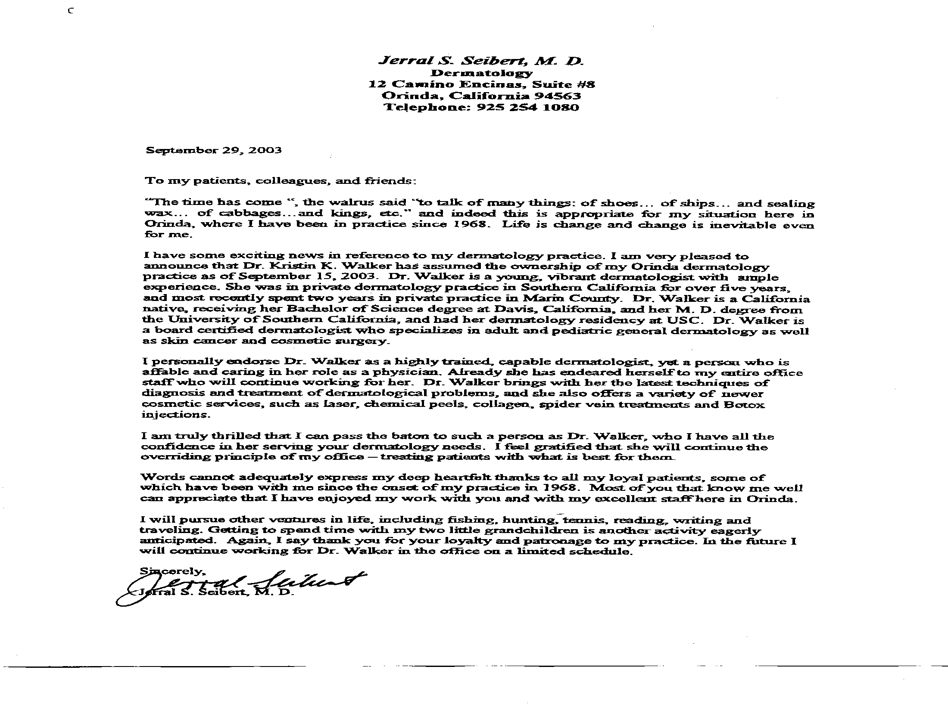

Slide 39
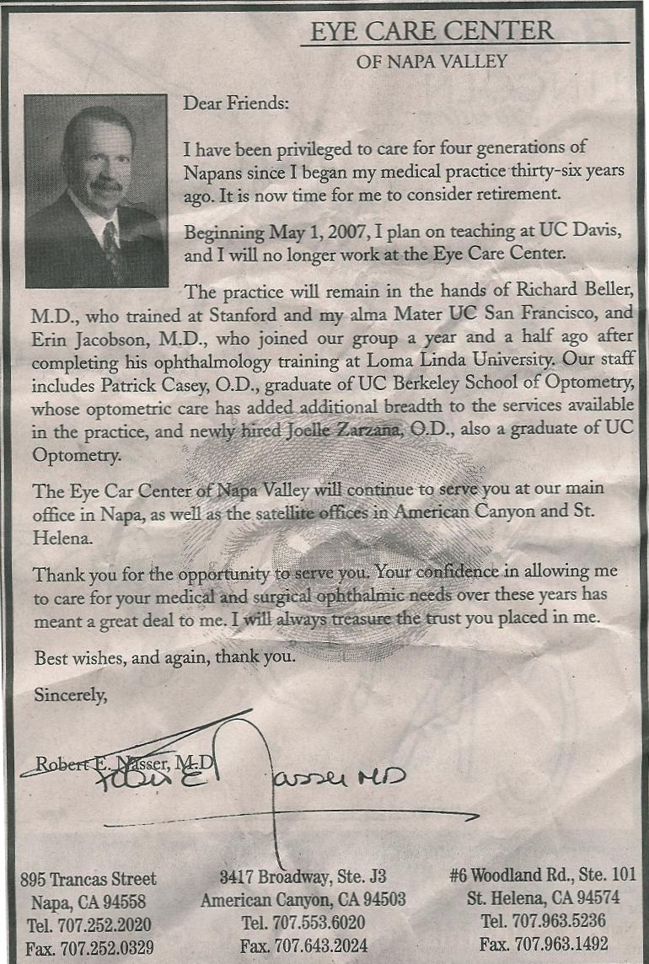

Slide 41
Disposition of Medical Records
Check laws regarding record retention
Transfer of Medical Records
You can send a photocopy to a new physician and keep original

Slide 42
If you release the Original Records to a New Physician:
They must assure you that they will retain the original record
They will make it available to you if you are involved in a lawsuit
If they dispose of the record, they should notify you
You should keep copies

Slide 43
Medical Records
Records retention
Assure availability
Sale of records – Custodian of Records charts only
Records belonging to the estate- Estate has same responsibility

Slide 44
Disposal of Drugs
Restocking with fee from Medical Supplier
Hazardous Waste Disposal Carrier
Controlled Drugs – 3 CA resources
EXP Pharmaceutical Services
Far West Returns
Outdate Rx, LLC

Slide 45
Disposal of Drugs
National Drug Take Back Day
April and October each year – Free Disposal at local participating police departments
http://www.deadiversion.usdoj.gov/drug_disposal/takeback/
Walgreens rolls out drug disposal kiosks at 500 stores

Slide 46
Controlled Drug Return

Slide 47
Need to deactivate your DEA
You must send letter to DEA
AFTER you have safely disposed of drugs
Contact DEA office in your state

Slide 48
Notification of IPAs/Payors
Check contracts may need to give 3 months for retirement
Medicare/Medi-Cal - Deactivate NPI

Slide 49
Notify State Medical Board
If death, permanent disability or retirement
If you intend to practice at all, don’t deactivate

Slide 50
Accounts Receivable
Clean up accounts
Hire collection agencies
Selling accounts receivable

Slide 51
Providing for Staff
Pension plans engender loyalty
Inform staff of plans
Offer references
Staff as negotiation tool

Slide 52
Who can Represent You in a Practice Sale?
Yourself
A real estate broker / agent
An attorney

Slide 53
Joint Venture Debra Phairas & Broker : David Greene and Norman Pearce
http://www.medicalpracticesusa.com

Slide 55
Reasons to List Your Practice for Sale:
Locate and screen potential buyers
Avoid hassle of details of sale
Avoid “giving away the shop”
Buffer by having a third person negotiate on your behalf

Slide 56
Evaluate Agent / Broker / Consultant:
Check credentials, interview previous clients
Where promises kept?
Was Service prompt and professional?
Did he/she negotiate effectively?
Would they use him/her again?

Slide 57
Selling to a Colleague or Associate:
There is still a good reason to involve a third party

Slide 58
Why a Practice Has Value:
Has a track record
Is probably making some money
No start-up costs
The price is less than it would cost to duplicate assets

Slide 59
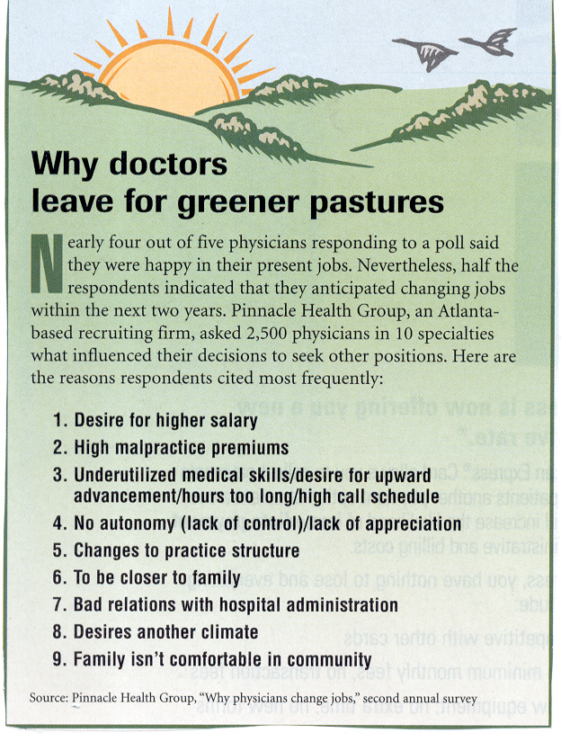

Slide 60
Quality of life more important to today's physicians
Medical Economics Publish date: Sep 26, 2012 By: Rachael Zimlich Jackson Coker
Females - They prefer suburban or urban locations in the Northeast and only relocated once or twice. This group most often specializes in dermatology, gynecology, infectious disease, or physical medicine and rehabilitation, according to the report.
Males - They either prefer rural locations or have no location preferences, according to the study. They had relocated three to six times over the course of their careers, which more often were specialized in neurology, psychiatry, or surgery.

Slide 61
Practice Appraisal
An estimate of value as of a specific date.

Slide 62
Why are Valuations Needed?
Selling practice assets to a hospital, or medical group
Retirement
Practice Merger
Buy-out
Buy-in
Private Equity
Divorce / Estate Planning

Slide 63
Items needed for an Appraisal
Three years of income tax returns
Three years of income and expense reports and balance sheets
Actual charges and contractual adjustments total for previous year
Aging spread and total accounts receivable

Slide 64
Items needed for an Appraisal
Fee schedule
List of assets purchased by date and cost at purchase, or depreciation schedule
Lease terms of office space
List of staff by position and hourly wage

Slide 65
Items needed for an Appraisal
The practice payor mix
Number of “active” charts or patients
Referral patterns
Unique services or aspects of the practice

Slide 66
Items needed for an Appraisal
IPA memberships
CV, practice brochure, mission statement, strategic plans

Slide 67
On-Site Appraisal
Verification of assets and condition
Location
Staff

Slide 68
On-Site Appraisal
Ambiance and patient relations
Marketing and promotion efforts
Practice systems and operations
Referral patterns

Slide 69
On-Site Appraisal
Medical Records/ EMR
Unique characteristics of practice
Competition
Economic and demographic conditions

Slide 70
Quality of Appraisal
Appraisal should assign a value to the assets to be included in the sale
An appraisal is only as good as the skill of the appraiser, and the information upon which the appraisal is based.
The sales price is determined by what a buyer is willing to pay, and what the seller will accept

Slide 71
Methods to Value a Practice
Rule of Thumb
Comparable Sales Method – Market Approach
Income Method
Discounted Cash flow or Excess Earnings

Slide 72
Private Equity
Excellent strategy – <3 years left in practice
Medium strategy – 3-10 years left
Think carefully > 10 years in practice
72

Slide 73
 |  | ANALYSIS OF PE DEAL VS. STAYING SOLO FOR 4 years and selling the practice
$ 2,850,000 | Price | $ 1,710,000 | cash up front to invest |  |  | 1,280,000 | Estimated Salary with PE 4 years
6 | Their Multiple |  |  | 741,000 | Capital gains tax | 2,109,000 | Amount Sale after capital gains
475,000 | Their EBITDA |  |  |  |  | 3,389,000
 |  |  |  |  |  | 3,300,000 | Solo Practice income and sale
 |  |  |  |  |  | 89,000 | Estimated increase with PE deal vs. staying solo
 |  |  |  |  |  |  | if at 700K per year
650,000 | Dr.estimated productivity |  |  |  |  | (311,000) | Estimate loss with PE deal vs staying solo
 |  |  |  |  |  |  | if you take out 800K from the practice
260,000 | 40% | will receive |  |  |  | PA productivity
30,000 | 50% | Product sales |  | 3% |  | 700,000 | 21,000
30,000 | 3% | PA |  | 3% |  | 300,000 | 9,000
320,000 | Estimated Salary | $ 1,280,000 |  |  |  |  | 300,00
 | Per year | 4 years

Slide 74
 |  |  | If remain in practice
800,000 | 2019 approximate Net and benefits |  | $ 700,000 | Per year net income and benefits minimum
 |  | 4 years | 4 | years
480,000 | Difference | 1,920,000 | $ 2,800,000 | 4 years net income benefits
 | in wage solo vs. PE | Difference 4 years | $ 500,000 | Sell the practice minimum sale
 | per year | 930,000.00 | 3,300,000 | TOTAL income plus sale of practice
 |  |  | $800,000 | Per year net income and benefits from the practice
 |  |  | 4
 |  |  | $3,200,000 | 4 years net income benefits
 |  |  | $500,000 | Sell the practice minimum sale
 |  |  | $3,700,000 | Total income and sale of practice

Slide 75
Serious Considerations
Do you like to be in control?
If you answer yes, think very long and hard about how you will adjust to being an employee
Larger organizations take longer to make decisions with more layers of bureaucracy
You may still need to get involved with administration/personnel/etc, but may have no power to change anything

Slide 76
Serious Considerations
Ask other physicians who are in the entity
What is the culture?
How happy are they?
Do you know your present office visit/hospital/surgery/procedure volume and how will this translate to WRVU compensation?
Will you be able to help choose/direct or fire staff that work with you? Will your office manager be eliminated?
What reporting of your productivity will you able to obtain and your rights to audit?
What if you were doing procedures now that add to your net income and these will be taken away to another specialty?

Slide 77
Serious Considerations
Will you have to see Charity and Medi-Cal patients?
Perform research?
Is the compensation formula vague or very specific?
Will you be forced to be in group with former competitors that you did not get along with?
What is the composition of board that makes decisions?
Weighted toward physicians or hospital/foundation/University?
Can you negotiate a 3-5 year guaranteed salary?

Slide 78
Hard Assets
Equipment
Straight-line Depreciation
Used Market Value
Replacement Cost
Exclude personal assets

Slide 79
https://www.medshare.org/ Donations of Medical Equipment

Slide 80
Supplies
Inventoried
Estimate supplies at 1-2 months of usual inventory costs

Slide 81
Frames
Wholesale Value, not Retail value

Slide 82
Accounts Receivable
Age of accounts
Factor the accounts by age
Subtract the contractual allowances from each aging

Slide 83
Valuing Intangibles including Goodwill
IRS ruling 59 - 60 and accounting standards define goodwill as:
“The expectation of future profits under the ownership of someone other than the present owner.”

Slide 84
Elements of Intangible Assets include:
Location
Type of practice
Referral patterns
Staff in place

Slide 85
Elements of Intangible Assets include:
Systems in place and operational
Financial performance - collection ratios, gross and net revenue
Non-compete clause

Slide 86
Elements of Intangible Assets include:
Transition assistance
Trade name
Contracting opportunities

Slide 87
Methods to Value Intangible Assets
The Goodwill Registry
(610) 828-3658 25.88% goodwill to revenues
Ophthalmology 2022 report
Market Approach – Revenue method or
Accumulation of Assets
Income Methods
Discounted Cash Flow or Excess Earnings

Slide 88
Medical Practice Revenue and Net Earnings
Bizcomps 2023
www.bizcomps.com
Medical Practice 1.73 Price per Sellers discretionary earnings (specialty specific)
Price per Gross Revenue =.56

Slide 89
Appraisals: An Art and a Science
Knowledge of the medical specialty
Knowledge of the marketplace
Estimating likelihood of the revenue stream continuing

Slide 90
Caveats about Pricing
Price realistically
Terms may be more than price

Slide 92
Finding a Buyer
Hospital recruiting
State and local medical associations
Specialty Societies
Broker
Internet Recruiting Sites

Slide 93
Finding a Buyer
Medical Meetings -
University and Residency Programs
Equipment and supply vendors
Physicians in your community

Slide 94
What should you advertise?
Specialty
Size or gross income
Geographical area

Slide 95
Negotiating Sale Terms
Using a professional will bring:
Higher sales price
Better terms negotiated
Loopholes closed
Less hassle to seller

Slide 96
Other Terms to Negotiate:
Purchase of Assets, Stock, or Partnership Interests
Ernest money deposit -- refundable or not
Down payment
Terms of any seller carry-back financing

Slide 97
Other Terms to Negotiate:
Allocation of purchase price
Equipment and supplies to be included
Covenant not to compete
Introductory services

Slide 98
Other Terms to Negotiate:
Who will pay closing costs
Pro-rations such as employee benefits, expenses, etc.
Whether accounts receivable will be part of the transaction
Provisions for records retention

Slide 99
Other Terms to Negotiate:
Life insurance on new buyer
Conduct until close of sale
Contract contingencies which must be removed prior to close of escrow

Slide 100
Other Terms to Negotiate:
Indemnification for prior acts
Protections against breach of agreement

Slide 101
Writing the Agreement
Details of the agreement must be in writing
A copy of the signed agreement should be used by the escrow officer

Slide 102
Help your Buyer Finance the Practice
Check with your bank for assistance
Bank of America (MD division)
Banks through the SBA
Check with your hospital

Slide 103
Personal Introduction
Offer to introduce new physician to patients and referring physicians
A powerful negotiating strategy

Slide 104
How to Save Taxes on the Practice Sale
Tax advice should be obtained from a professional
Review your position in advance with accountant

Slide 105
Recommendations for Bringing in a New Associate:
Write an employment offer spelling out conditions and expectations
State all AR, charts, lists, etc. are employers property
Have approximate cost decided before the interview process begins

Slide 106
Practice Link

Slide 107
Recommendations for Bringing in a New Associate:
Create an incentive program
After incentive is reached, additional money generated should be given as bonus, or put in escrow for buy-in

Slide 108
Discuss Salary and Benefits
Market comparable salary?
How is it paid?
Incentive bonus?
Malpractice and Tail?
Benefits, life, health, disability? Pension and profit sharing?
Auto?

Slide 109
Example
300,000 MD Salary +
25,000 Benefits
325,000 Physician Cost +
150,000 Additional Overhead Cost =
475,000 Breakeven Point MD needs
to generate revenue

Slide 110
Incentive Bonus
After Employee reaches breakeven point, additional revenue goes to overhead, Employer return on investment and Employee bonus
10,000
5,000 Overhead (50%)
2,500 Employer (25%)
2,500 Employee (25%)

Slide 111
Buy - In
Can you review the partnership agreement?
What is the methodology for buy-in?
Can intangible asset value be established at point of entry?
Can the buy-in be spread over several years?

Slide 112
Mergers
Merging with another MD or group can provide the transition
Removes records issues
Provides buy-out

Slide 113
Professional Assistance Needed:
Appraiser / Consultant
Broker
Attorney
CPA

Slide 114
Thank you for attending!
Debra Phairas
dphairas@practiceconsultants.net
(415) 764-4800
www.practiceconsultants.net
www.medicalpracticesusa.com

